Slide 1
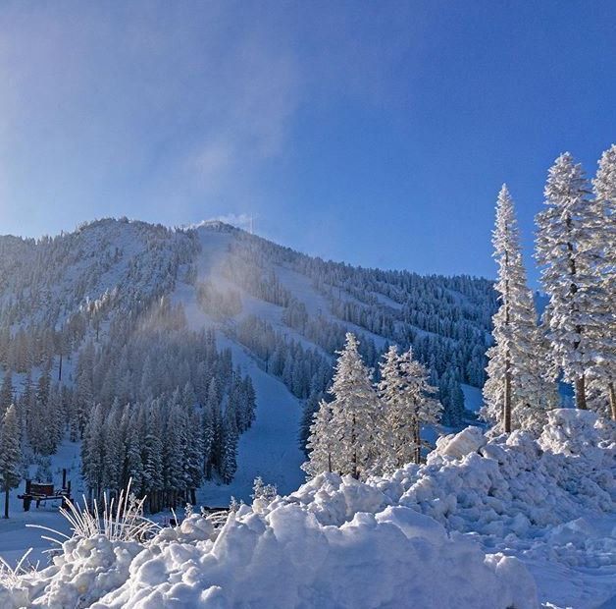
SPECIAL USE PERMIT CASE NUMBER
WSUP19-0021
(Mt. Rose Water Tank)
Washoe County Board of Adjustment
December 5, 2019

Slide 2
Request
Construction of a 5-million-gallon snowmaking water tank, a civic use type on two properties that are part of the ski resort
  Installation of new piping underground to connect the new tank to the existing waterline
  Construction of a maintenance road around the perimeter of the tank
  Construction of a keystone or redi-rock retaining wall

Slide 3
Request Continued…
Site is zoned Open Space and Parks and Recreation
Major grading:
  Grading to construct a permanent earthen structure >6 ft. in height
  ±5,720 cubic yards of cut
Vary grading, landscaping, and setback standards
8-year approval timeframe

Slide 4
Overall Request
Expand the Mt. Rose ski resort
  Renovate existing infrastructure
  Construct new maintenance structures
  Expand the resort area to the northern side of the Mt. Rose Highway via a proposed skier bridge

Slide 5
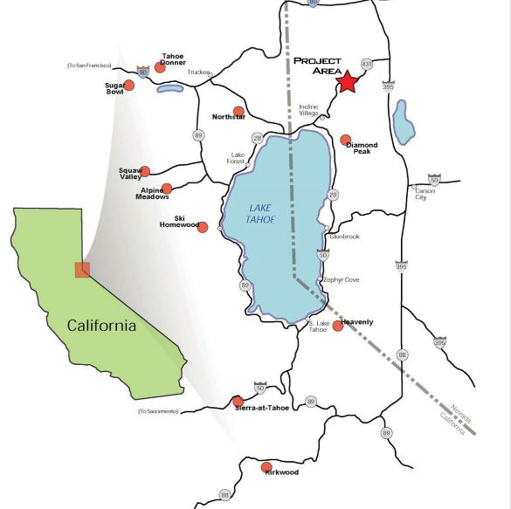
Location
Mt. Rose Ski Tahoe

Slide 6
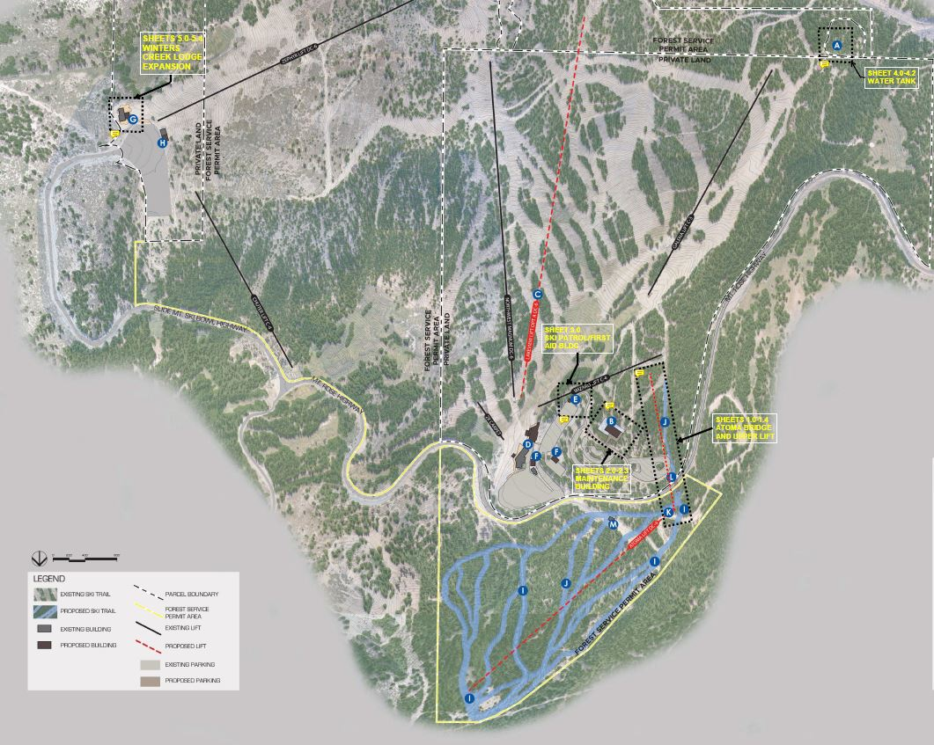
Overall Site Plan
U.S. Forest Service
Tank Location
Mt. Rose Development Co.

Slide 7
Environmental Impact Statement
Development proposals on public lands require a review of environmental impacts and alternatives.
In February of 2019, the final environmental impact statement (FEIS) and draft record of decision (ROD) were completed.
In November of 2019, the final ROD for the water tank was issued.

Slide 8
Final Record of Decision
The U.S. Forest Service authorizes the construction of the water tank, subject to local approval/permits.
The final ROD includes management requirements to mitigate environmental impacts.
Condition of approval 1.e requires compliance with all management requirements identified by the USFS

Slide 9
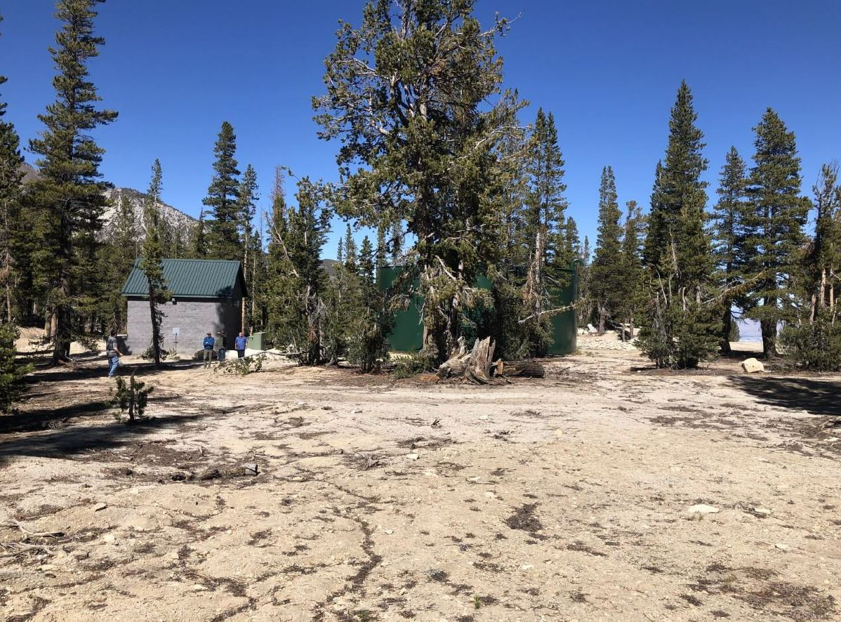
Location

Slide 10
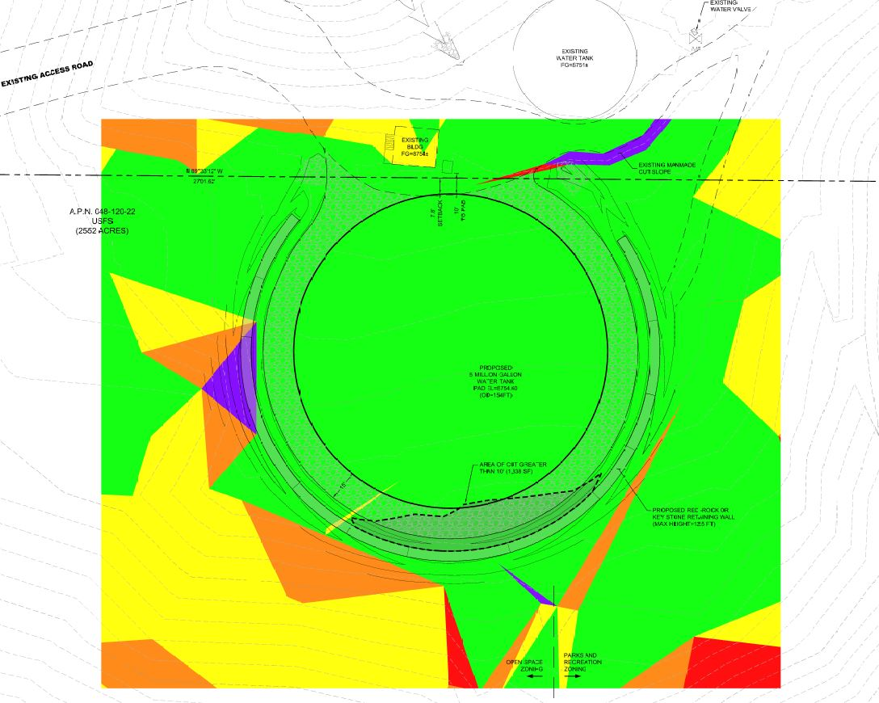
Slope Analysis

Slide 11
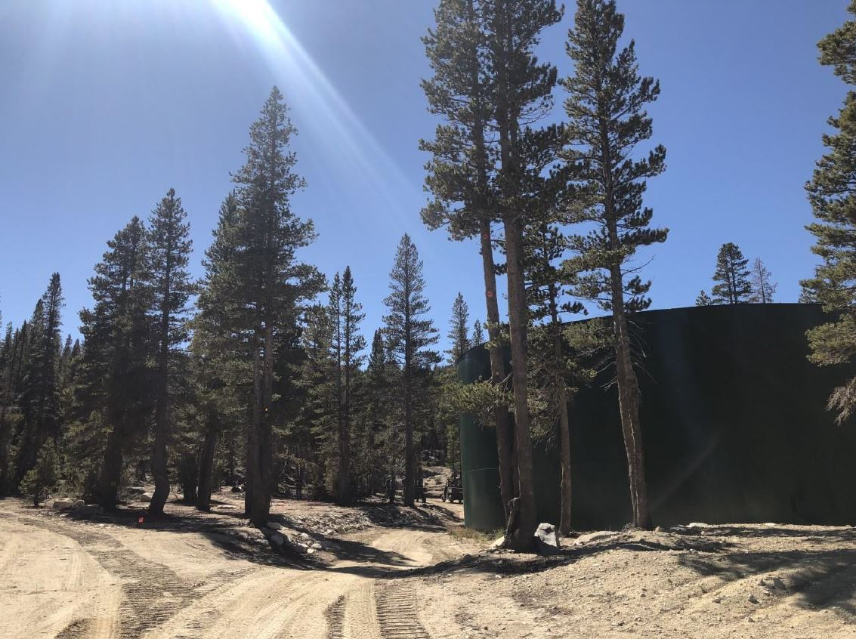
Access Road

Slide 12
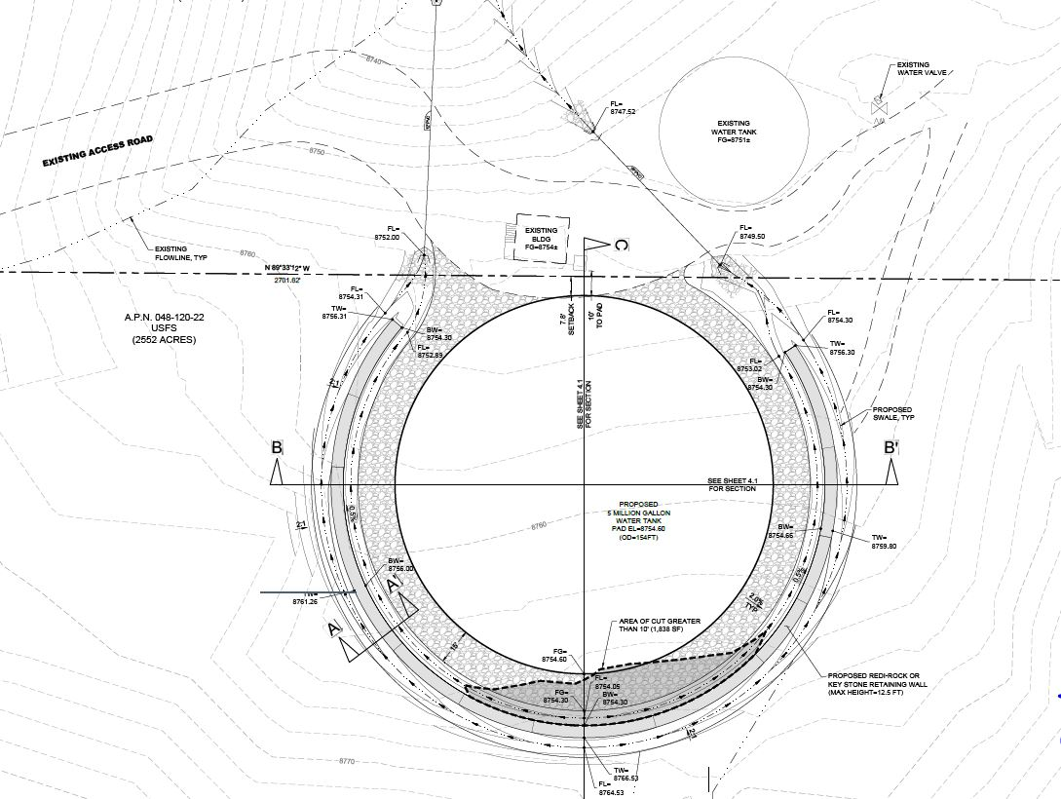
Tank Site Plan

Slide 13
Grading
Modify WCC Section 110.438.45(a)—3:1 slopes required
WCC Section 110.438.45(a)(4)—This requirement can be modified if:
  The proposed slope would be located behind a civic building
  The cut slope would be shorter than and substantially screened by the building

Slide 14
Grading
Vary WCC Section 110.438.45(c)—Finish grading shall not vary from the natural slope by more than (10) ten feet in elevation.
The proposed grading would vary from the natural slope by a maximum of 12.5 ft.
Staff recommends approval of this request:
  Supported by the Forest Service and on Forest Service property
  Supported by Washoe County’s Engineering Division
  Supported by the geotechnical summary

Slide 15
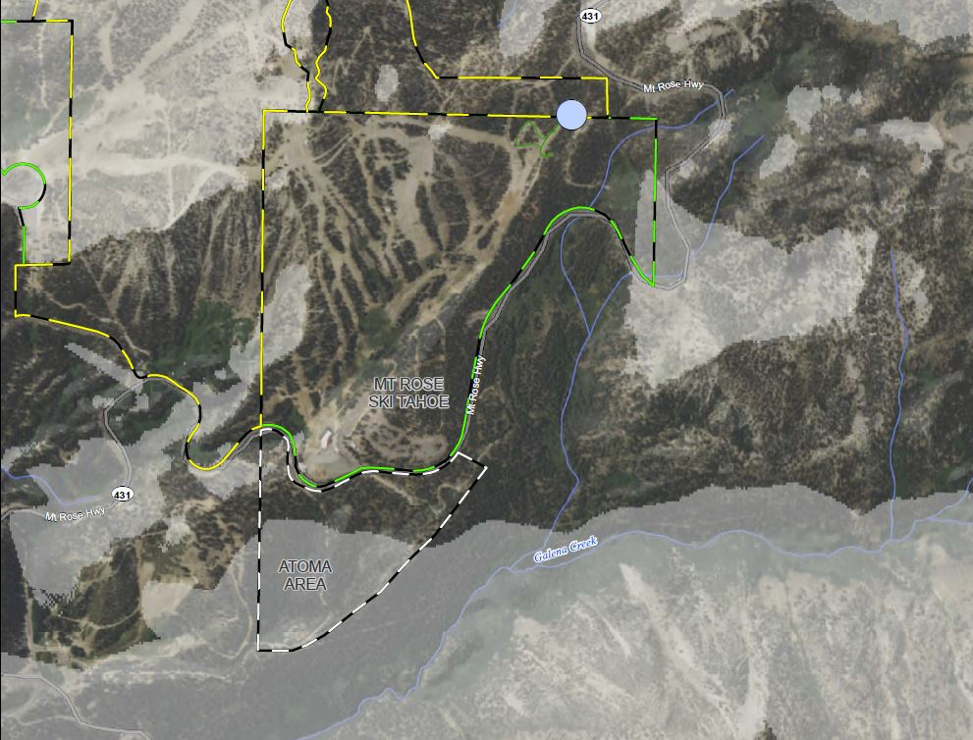
Setbacks
USFS
Proposed Water Tank Location
Mt. Rose Development Co.

Slide 16
Slope Analysis

Slide 17
Landscaping
WCC Section 110.412.40(a)—A minimum of 20% of the total developed land area must be landscaped
Site is surrounded by densely forested area
Staff have concluded that ornamental landscaping would be inappropriate and support varying this standard
All disturbed areas outside of the tank footprint must be revegetated utilizing a native, dryland seed mixture

Slide 18
Visual Impacts
±700 feet from Mt. Rose Highway and would be well-screened by existing vegetation
Tank must be treated or painted a non-reflective, muted color that blends with background to mitigate impacts
No lighting proposed

Slide 19
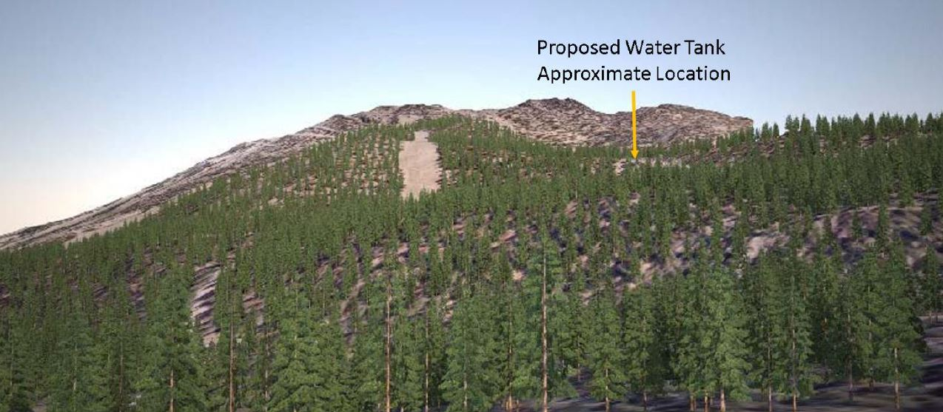
Visual Impacts

Slide 20
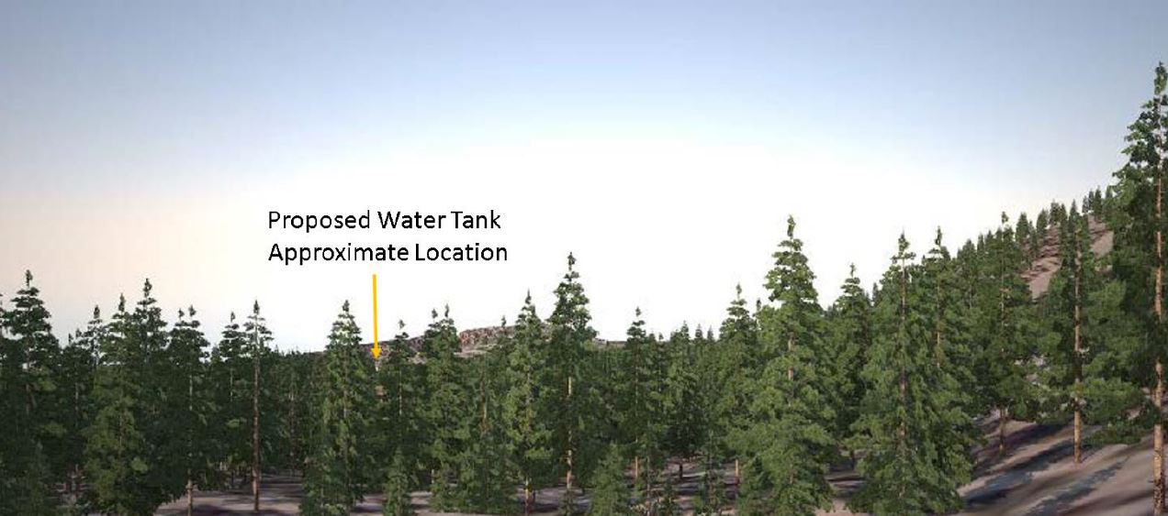
Visual Impacts

Slide 21
Public Notice & CAB
Notice sent to 42 affected property owners
This item was reviewed at the South Truckee Meadows/Washoe Valley CAB meeting on October 3, 2019. The CAB voted unanimously in support of the proposal.

Slide 22
Reviewing Agencies
Washoe County Community Services Dept.
Washoe County Health District
Washoe County Regional Animal Services
US Fish & Wildlife
US Forest Service
State of Nevada (Divisions of Environmental Protection, Forestry, Parks, State Lands, Water Resources, Transportation, and Wildlife)
Nevada State Historic Preservation Office
Truckee Meadows Fire Protection District
Regional Transportation Commission
Washoe-Storey Conservation District
Washoe County Sheriff

Slide 23
Forest Area Plan Findings
F.2.13—The approval of all special use permits and administrative permits must include a finding that the community character as described in the Character Statement can be adequately conserved through mitigation of any identified potential negative impacts.

Slide 24
Forest Area Plan Findings
F.12.3—The granting of special use permits in the Forest planning area must be accompanied by a finding that no significant degradation of air quality will occur as a result of the permit. As necessary, conditions may be placed on special use permits to ensure no significant degradation of air quality will occur. The Department of Community Development (now the Community Services Department) will seek the advice and input of the Air Quality Division of the Department of Health in the implementation of this policy.

Slide 25
Special Use Permit Findings
Consistency. That the proposed use is consistent with the action programs, policies, standards and maps of the Master Plan and the Forest Area Plan;
Improvements. That adequate utilities, roadway improvements, sanitation, water supply, drainage, and other necessary facilities have been provided, the proposed improvements are properly related to existing and proposed roadways, and an adequate public facilities determination has been made in accordance with Division Seven;
Site Suitability. That the site is physically suitable for a 5-million-gallon water tank, and for the intensity of such development;
Issuance Not Detrimental. That issuance of the permit will not be significantly detrimental to public health, safety or welfare; injurious to the property of improvements of adjacent properties; or detrimental to the character of the surrounding area;
Effect on a Military Installation. Issuance of the permit will not have a detrimental effect on the location, purpose of mission of the military installation.

Slide 26
Possible Motion
I move that, after giving reasoned consideration to the information contained in the staff report and information received during the public hearing, the Washoe County Board of Adjustment approve with conditions Special Use Permit Case Number WSUP19-0021 for the Mt. Rose Development Company, to include varying WCC Section 110.412.40(a), Coverage, Civic and Commercial Use Types, Landscaping and WCC Section 110.438.45(c), Grading of Slopes, Grading Standards, and the modification to WCC Section 110.438.45(a), Grading of Slopes, Grading Standards, and WCC Table 110.406.05.1, Standards, having made all five findings in accordance with Washoe County Code Section 110.810.30, and the two findings in accordance with the Forest Area Plan.

